Slide 1

Project Management & IT: Approaches to Systems Development
Chapter 2 of Information Technology Project Management, 7th Edition
…and more!
Prof. Inas Ezz
Based on Prof. Ralf Klischewski- Dr. Elshimaa
El Gendi- Edited

Slide 2
Project Management
Introduction

Slide 3
Highlights on Course Importance ☺

Slide 4
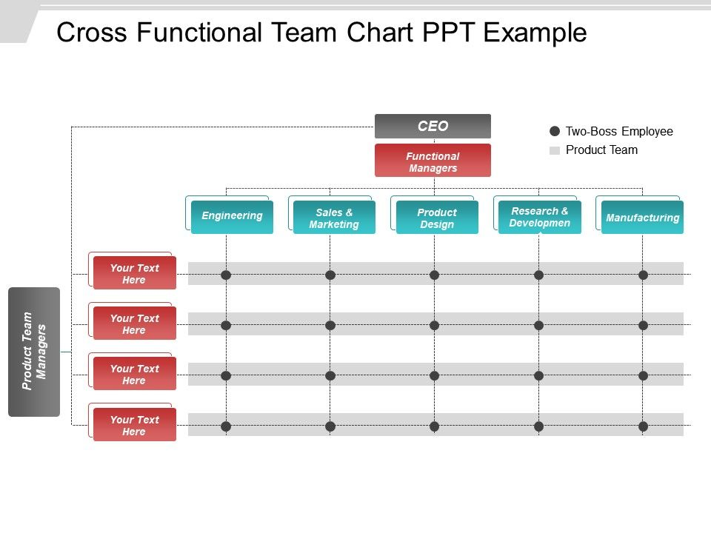

Slide 5
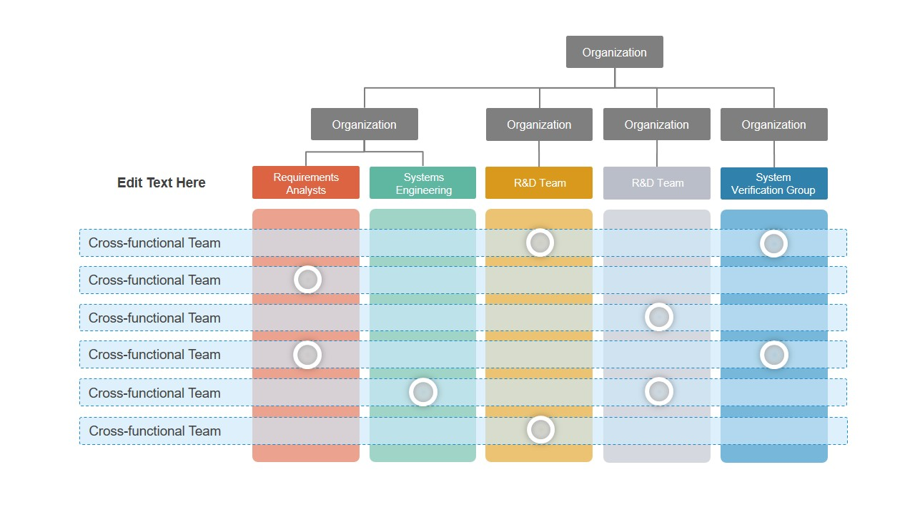

Slide 6
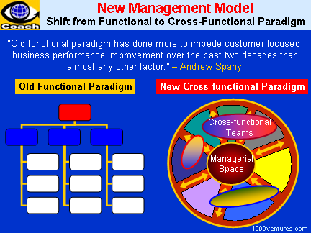

Slide 7
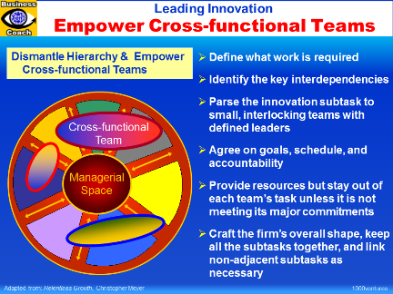

Slide 8
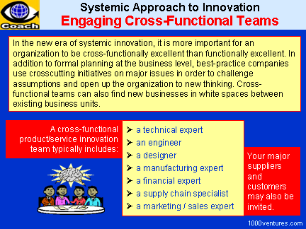

Slide 9
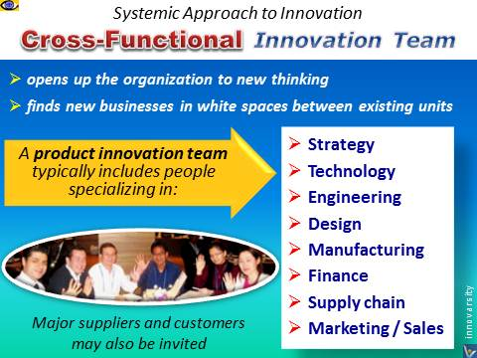

Slide 10
Quick Revision

Slide 11
What Is a Project?
A project is “a temporary endeavor undertaken to create a unique product, service, or result” (PMBOK® Guide, 5th Edition, 2012)
Project management is “the application of knowledge, skills, tools and techniques to project activities to meet project requirements” (PMBOK® Guide, 5th Edition, 2012)
Attributes of projects:
has a unique purpose
has structure, but is temporary
is developed using progressive elaboration
requires resources, often from various areas
should have a primary customer or project sponsor who usually provides the direction and funding for the project
involves uncertainty

Slide 12
Examples…
A major event like a wedding
Any construction project
Designing a political campaign
Developing a new software
Update current system

Slide 13
What is not a project?
Emergency response to operations problems
Callouts
Repairs and troubleshooting
Routine operations support
Maintenance of equipment
Minor modifications and tuning of equipment
Issuance of reports on the inventory status

Slide 14
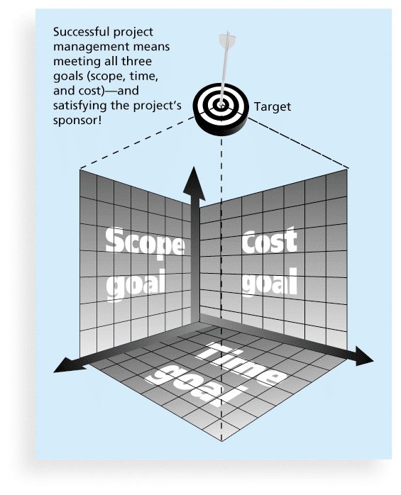
Triple Constraint of Project Management

Slide 15
Triple Constraint
Increased Scope = increased time + increased cost
Tight Time = increased costs + reduced scope
Tight Budget = increased time + reduced scope.

Slide 16

Project Success
Customer Requirements satisfied/exceeded
Completed within allocated time frame
Completed within allocated budget
Accepted by the customer

Slide 17

Project Failure
Scope Creep
Poor Requirements Gathering
Unrealistic planning and scheduling
Lack of resources

Slide 18
What Helps Projects Succeed?*
1. User involvement
2. Executive support
3. Clear business objectives
4. Emotional maturity
5. Optimizing scope
6. Agile process
7. Project management expertise
8. Skilled resources
9. Execution
10. Tools and infrastructure
*The Standish Group, “CHAOS Activity News” (August 2011).

Slide 19
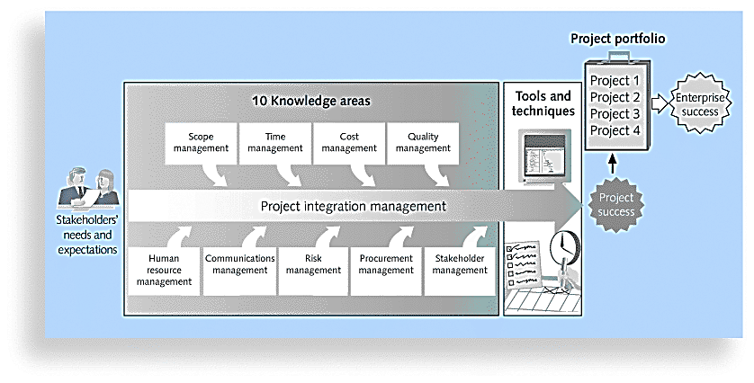
Project Management Framework

Slide 20
Role of a Project Manager
Project issues
Disseminating project information
Mitigating project risk
Quality
Managing scope
Metrics
Managing the overall work plan
Implementing standard processes
Establishing leadership skills
Setting expectations
Team building
Communicator skills
Process Responsibilities
People Responsibilities
Notes:
Process Responsibilities
The project manager normally is responsible for defining and planning the project. This results in the completion of a Project Definition and a project workplan. Once the project starts, the project manager must successfully manage and control the work, including:
Identifying, tracking managing and resolving project issues
Proactively disseminating project information to all stakeholders
Identifying, managing and mitigating project risk
Ensuring that the solution is of acceptable quality
Proactively managing scope to ensure that only what was agreed to is delivered, unless changes are approved through scope management
Defining and collecting metrics to give a sense for how the project is progressing and whether the deliverables produced are acceptable
Managing the overall workplan to ensure work is assigned and completed on time and within budget
To manage the project management processes, a person should be well organized, have great follow-up skills, be process oriented, be able to multi-task, have a logical thought process, be able to determine root causes, have good analytical ability, be a good estimator and budget manager, and have good self-discipline.
People Responsibilities
In addition to process skills, a project manager must have good people management skills. This includes:
Having the discipline and general management skills to make sure that people follow the standard processes and procedures
Establishing leadership skills to get the team to willingly follow your direction. Leadership is about communicating a vision and getting the team to accept it and strive to get there with you.
Setting reasonable, challenging and clear expectations for people, and holding them accountable for meeting the expectations. This includes providing good performance feedback to team members
Team building skills so that the people work together well, and feel motivated to work hard for the sake of the project and their other team members. The larger your team and the longer the project, the more important it is to have good team-building skills.
Proactive verbal and written communicator skills, including good, active listening skills.
Multiple Roles
Depending on the size and complexity of the project, the project manager may take on other responsibilities in addition to managing the work. For instance, the project manager may assist with gathering business requirements. Or they may help design a database management system or they may write some of the project documentation. Project management is a particular role that a person fills, even if the person who is the project manager is working in other roles as well.

Slide 21
Project Management & IT: Approaches to Systems Development
Chapter 2 of Information Technology Project Management, 7th Edition

Slide 22
Learning Objectives
Describe the systems view of project management and how it applies to information technology (IT) projects
Discuss the unique attributes and diverse nature of IT projects
Explain why stakeholder management is critical for a project’s success
Understand the concept of a project phase and the project life cycle
Distinguish between project development and product development
Distinguish between predictive and adaptive life cycle models
Describe recent trends affecting IT project management

Slide 23
Projects cannot be run in isolation
Projects must operate in a broad organizational environment
Project managers need to use systems¹ thinking:
taking a holistic view of carrying out projects within the context of the organization [→ integration management]
Senior managers must make sure projects continue to support current business needs
¹systems — Sets of interacting components working within an environment to fulfill some purpose

Slide 24
Systems Management
Addresses the business, technological, and organizational issues associated with creating, maintaining, and modifying a system.

Slide 25
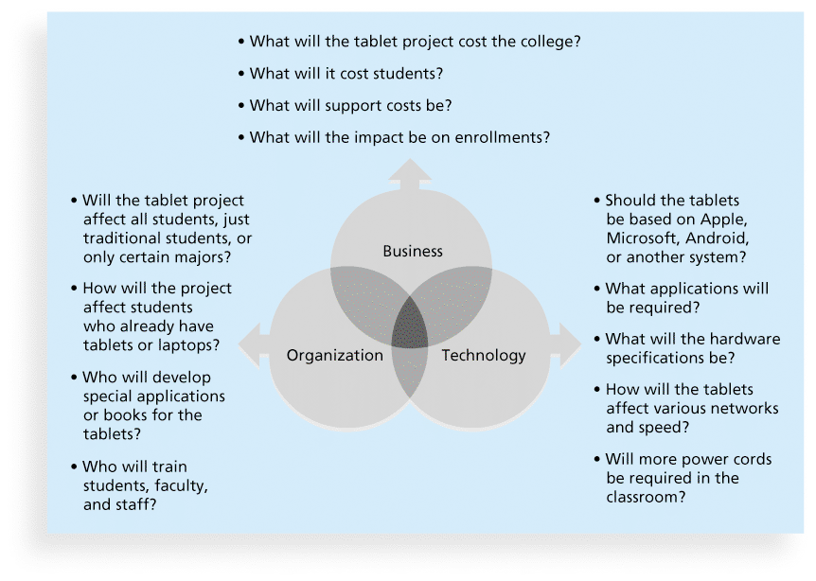
3 Sphere Model for Systems Management

Slide 26
Learning Objectives
Describe the systems view of project management and how it applies to information technology (IT) projects
Discuss the unique attributes and diverse nature of IT projects
Explain why stakeholder management is critical for a project’s success
Understand the concept of a project phase and the project life cycle
Distinguish between project development and product development
Distinguish between predictive and adaptive life cycle models
Describe recent trends affecting IT project management

Slide 27
Diversity of IT Projects
IT projects can be very diverse in terms of size, complexity, products produced, application area, and resource requirements
IT project team members often have diverse backgrounds and skill sets
IT projects use diverse technologies that change rapidly. Even within one technology area, people must be highly specialized

Slide 28
IT / IS / SD Projects
IT project refers to projects involving hardware, software, and networks
IS project refers to projects involving applications that serve the informational needs of IS users
Systems development refers to projects bringing out IS that did not exist before

Slide 29
Systems development (SD)
Activities that
Go into producing information systems solutions
Get the information system “up and running”
Change an organization through the use of computer technology

Slide 30
Learning Objectives
Describe the systems view of project management and how it applies to information technology (IT) projects
Discuss the unique attributes and diverse nature of IT projects
Explain why stakeholder management is critical for a project’s success
Understand the concept of a project phase and the project life cycle
Distinguish between project development and product development
Distinguish between predictive and adaptive life cycle models
Describe recent trends affecting IT project management

Slide 31
STAKEHOLDER MANAGEMENT
Includes identifying, understanding, and managing relationships with all project stakeholders.

Slide 32
STAKEHOLDER MANAGEMENT
project stakeholders are the people involved in project activities or affected by them.
Stakeholders can be internal or external to the organization,
Internal project stakeholders generally include the project sponsor, project team, support staff, and internal customers for the project. Other internal stakeholders include top management, other functional managers, and other project managers.
Because organizations have limited resources, projects affect top management, other functional managers, and other project managers by using those resources.
External project stakeholders include the project’s customers (if they are external to the organization), competitors, suppliers, and other external groups potentially involved in the project or affected by it, such as government officials or concerned citizens.

Slide 33
Learning Objectives
Describe the systems view of project management and how it applies to information technology (IT) projects
Discuss the unique attributes and diverse nature of IT projects
Explain why stakeholder management is critical for a project’s success
Understand the concept of a project phase and the project life cycle
Distinguish between project development and product development
Distinguish between predictive and adaptive life cycle models
Describe recent trends affecting IT project management

Slide 34
Project Phases & Project Life Cycle
A project life cycle is a collection of project phases that defines
what work will be performed in each phase
what deliverables will be produced and when
who is involved in each phase, and
how management will control and approve work produced in each phase
A deliverable A deliverable is a product or service, such as a technical report, a training session, a piece of hardware, or a segment of software code, produced or provided as part of a project.

Slide 35
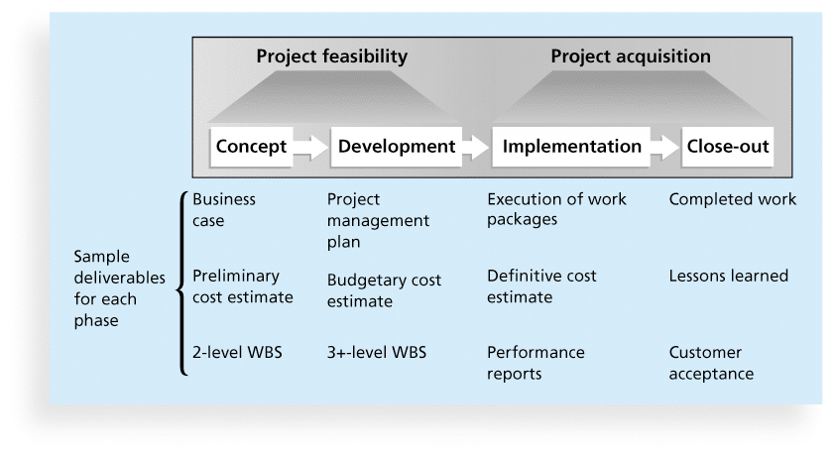
Phases of the Traditional Project Life Cycle

Slide 36
Importance of Project Phases & Management Reviews
A project should successfully pass through each of the project phases in order to continue on to the next
Management reviews, also called phase exits or kill points, should occur after each phase to evaluate the project’s progress, likely success, and continued compatibility with organizational goals

Slide 37
Learning Objectives
Describe the systems view of project management and how it applies to information technology (IT) projects
Discuss the unique attributes and diverse nature of IT projects
Explain why stakeholder management is critical for a project’s success
Understand the concept of a project phase and the project life cycle
Distinguish between project development and product development
Distinguish between predictive and adaptive life cycle models
Describe recent trends affecting IT project management

Slide 38
Project vs. Product Life Cycles
The project life cycle applies to all projects, regardless of the products being produced
Products also have life cycles: product life cycle models vary considerably based on the nature of the product
Most large IT systems are developed as a series of projects
Project management is done in all of the product life cycle phases

Slide 39
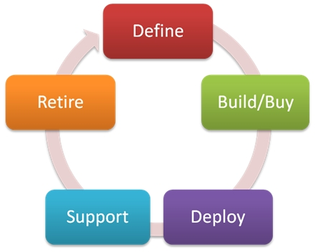
Product Life Cycles in IT/IS
The Systems Development Life Cycle (SDLC)
is a framework for describing the phases involved in developing and maintaining information systems
partitions systems development process into formal stages that must be completed sequentially

Slide 40
Learning Objectives
Describe the systems view of project management and how it applies to information technology (IT) projects
Discuss the unique attributes and diverse nature of IT projects
Explain why stakeholder management is critical for a project’s success
Understand the concept of a project phase and the project life cycle
Distinguish between project development and product development
Distinguish between predictive and adaptive life cycle models
Describe recent trends affecting IT project management

Slide 41
Product Life Cycles in IT/IS
Systems development projects can follow
Predictive models: the scope of the project can be clearly articulated and the schedule and cost can be predicted
Adaptive models: requirements cannot be clearly expressed, projects are mission driven and component based, using time-based cycles to meet target dates

Slide 42
Predictive Life Cycle Models
Waterfall model: has well-defined, linear stages of systems development and support
Spiral model: shows that software is developed using an iterative or spiral approach rather than a linear approach

Slide 43
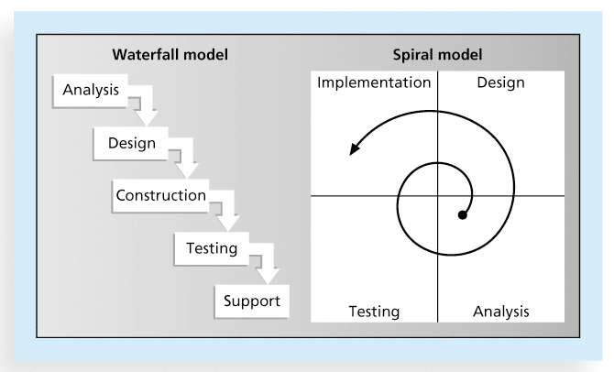
Waterfall & Spiral Life Cycle Models

Slide 44
Assumptions of the Waterfall Model
Requirements
are knowable in advance of implementation
have no unresolved implications
will not change very much
The right architecture for implementation is well communicated and understood
Processes can be proceed sequentially
Requirements are compatible with stakeholders’ expectations

Slide 45
From Prediction to Adaptation
Prototyping model: used for developing prototypes to clarify user requirements for operational software - It requires heavy user involvement. Developers can throw away or keep prototypes, depending on the project. This approach is often used in systems that involve a great deal of user interface design, such as Web site projects
Rapid Application Development (RAD) model: used to produce systems (→ evolving prototype) quickly without sacrificing quality – Developers use RAD tools such as CASE (computer-aided software engineering) to facilitate rapid prototyping and code generation.
Incremental build model: provides for progressive development of operational software - This type of approach is often used by organizations like Microsoft, which issues a specific release of a software package while working on future revisions that will be distributed later in another release with a higher “build” or version number.

Slide 46
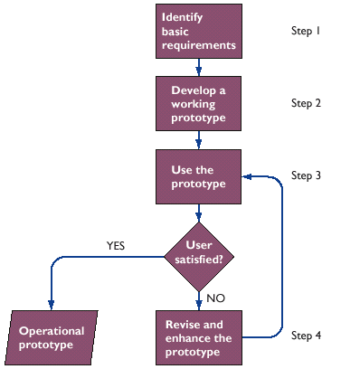
The Prototyping Process
Prototype
Preliminary working version of information system for demonstration and evaluation
Prototyping
Process of building experimental system quickly and inexpensively for demonstration and evaluation

Slide 47
Advantages and Disadvantages of Prototyping
Prototyping advantages
Useful in designing information system’s end-user interface
Useful in testing validity of end user requirements and system acceptance
Prototyping disadvantages
Rapid prototyping can gloss over essential steps in systems development
Only limited number of users can be involved

Slide 48
Learning Objectives
Describe the systems view of project management and how it applies to information technology (IT) projects
Discuss the unique attributes and diverse nature of IT projects
Explain why stakeholder management is critical for a project’s success
Understand the concept of a project phase and the project life cycle
Distinguish between project development and product development
Distinguish between predictive and adaptive life cycle models
Describe recent trends affecting IT project management

Slide 49
Trends Affecting IT Project Management
Globalization
Outsourcing, an organization acquires goods and/or services from an outside source [→ procurement!]
Offshoring is sometimes used to describe outsourcing from another country
Virtual teams work across time and space using communication technologies
Agile project management

Slide 50
Agile Software Development
Has become popular to describe new approaches that focus on close collaboration between programming teams and business experts
Is a methodology that describes how to manage projects (not best practice for what should be done to manage projects)
Agile SD methods include:
Extreme Programming (XP)
Scrum

Slide 51
Agile Project Management
Agile means being able to move quickly and easily, but some people feel that project management, as they have seen it used, does not allow people to work quickly or easily.
Early software development projects often used a waterfall approach, as defined earlier in this chapter. As technology and businesses became more complex, the approach was often difficult to use because requirements were unknown or continuously changing.
Agile today means using a method based on iterative and incremental development, in which requirements and solutions evolve through collaboration.

Slide 52
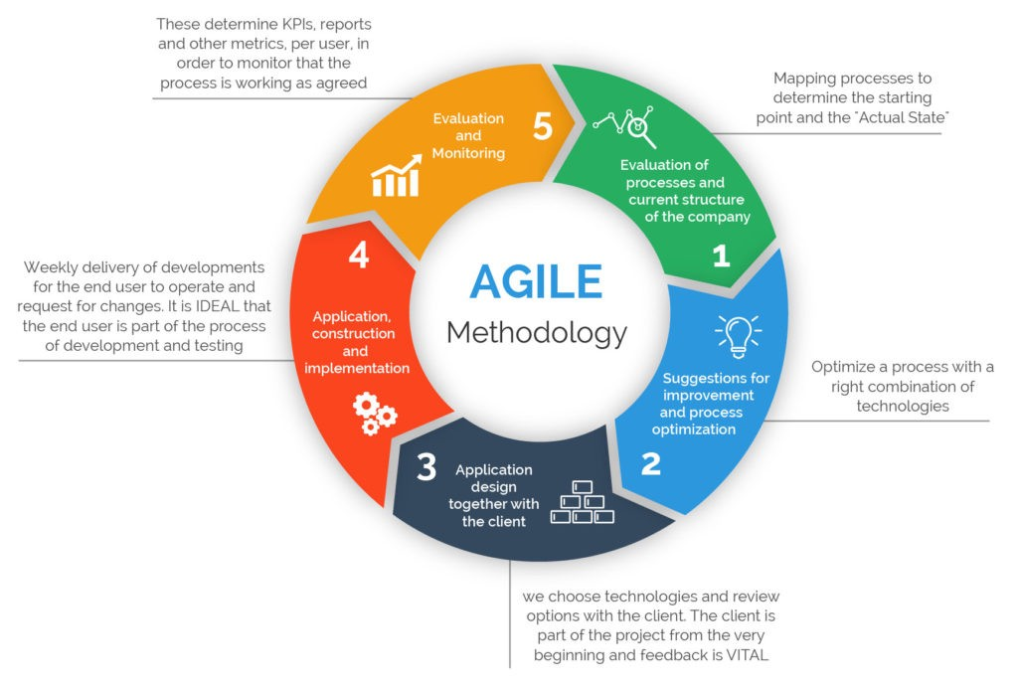

Slide 53
Agile Software Development http://agilemanifesto.org/
Individuals & interactions Over processes and tools
Working software Over comprehensive documentation
Customer collaboration Over contract negotiation
Responding to change Over following a plan

Slide 54
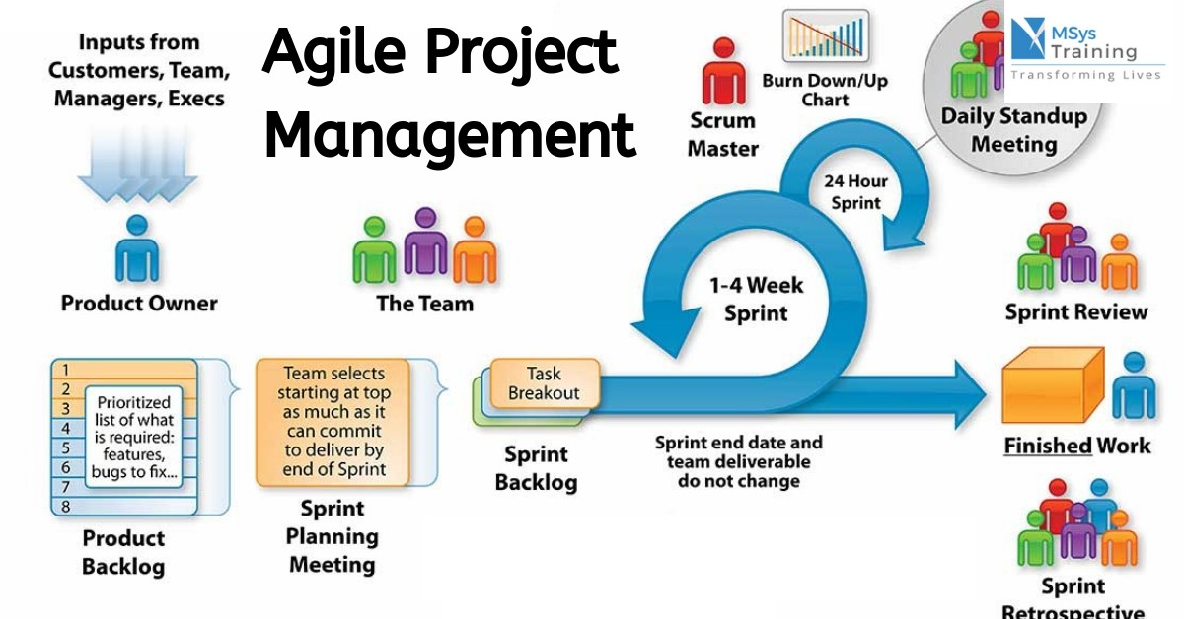
In project management, a 'sprint' refers to a set period of time during which a certain task or activity is completed and then reviewed. Sprint is one time-boxed iteration of a continuous development cycle. Within a Sprint, planned amount of work has to be completed by the team and made ready for review. ... Sprint literal meaning is a short race at full speed. Accordingly, teams usually define a short duration of a Sprint up to 2-4 weeks.

Slide 55
Scrum*
the leading agile development method for completing projects with a complex, innovative scope of work (according to the Scrum Alliance)
Scrum is a framework for project management that emphasizes teamwork, accountability and iterative progress toward a well-defined goal. The framework begins with a simple premise: Start with what can be seen or known. ... The framework, which is often part of Agile software development, is named for a rugby formation.
An iterative, incremental framework for project management & agile software development
* The term was coined in 1986 in a Harvard Business Review study that compared high-performing, cross-functional teams to the scrum formation used by rugby teams.

Slide 56
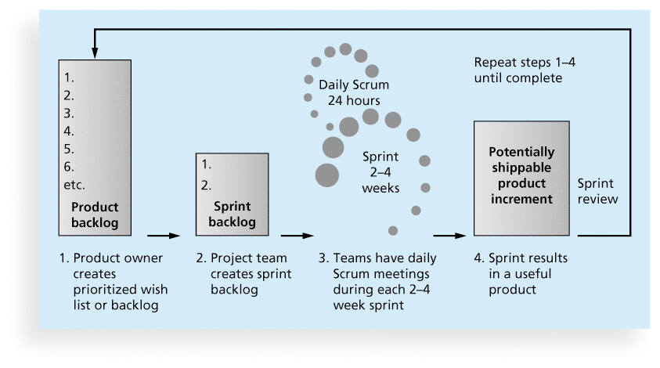
Scrum Framework

Slide 57
Scrum: main roles
Scrum Master: maintains the processes
Product Owner: represents the business (and/or stakeholders)
Team: a cross-functional group of people who do the actual analysis, design, implementation, testing, etc.
… and customers, vendors, managers (“chicken roles”): people for whom the software is being built

Slide 58
Chapter Summary
Project managers need to consider several success factors due to varying scope & unique context of IT projects
Projects should successfully pass through each phase of the project life cycle
Project managers need to take a systematic approach and distinguish between predictive and adaptive life cycle models
Recent trends affecting IT project management include globalization, outsourcing, virtual teams, and agile approaches

Slide 59
Project Management….
Work Smart Not Hard !!!

Slide 60
https://ocw.mit.edu/courses/civil-and-environmental-engineering/1-040-project-management-spring-2004/

